Slide 1

Enterprise systems
Unit 1
By- simran s

Slide 2
Enterprise systems
Enterprise systems are large-scale software packages that are able to track and control all of the complex operations of a business. These systems are used as a central command hub to help automate the business and make reporting and decision making easier.

Slide 3
1. Store Business Data in a Usable Format
2. Automate the Customer Service Process for Employees
3. Scale Available Resources (Up and Down) as Needed
4. Maximize the Reliability of IT Infrastructure Necessary for Customer Service
10 Ways Enterprise Systems Affect your Business
10. Ensure Regulatory Compliance
5. Secure Customer Data
9. Improve Supply Chain Management
8. Standardized Process
7. Reduce the Cost of Doing Business
6. Real-Time Access to Information

Slide 4
Business
Information System
Decision Support Systems
ELEMENTS OF ENTERPRISE SYSTEMS
Financial And Human Resource Systems
Knowledge Management
Systems

Slide 5
Business Information System
Business information systems provide information that organizations use to manage themselves efficiently and effectively, typically using computer systems and technology. Primary components of business information systems include hardware, software, data, procedures (design, development, and documentation) and people.

Slide 6
Primary Components Of Business Information Systems
HARDWARE
SOFTWARE
DATA PROCEDURE
PEOPLE

Slide 7
Decision support systems
A decision support system (DSS) is a computer program application used to improve a company's decision-making capabilities. It analyses large amounts of data and presents an organization with the best possible options available.
Decision support systems bring together data and knowledge from different areas and sources to provide users with information beyond the usual reports and summaries. This is intended to help people make informed decisions.

Slide 8
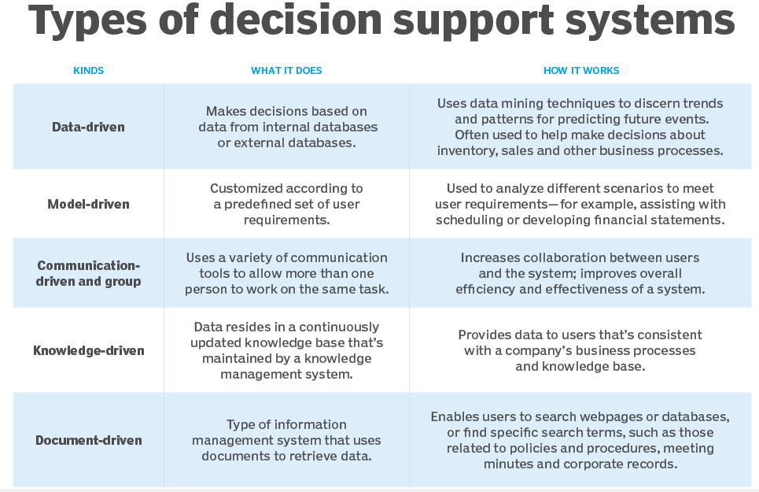

Slide 9
Knowledge management systems
A knowledge management system (KMS) is a tool used by companies to help organize documentation, frequently asked questions, and other information into easily accessible formats for both internal and external customers.

Slide 10
Financial and human resource systems
A financial system is a set of institutions, such as banks, insurance companies, and stock exchanges, that permit the exchange of funds. Financial systems exist on firm, regional, and global levels.
Human resources management system, is a suite of software applications used to manage human

Slide 11
Kinds of Enterprise systems - B2B model
Business-to-business (B2B), also called B-to-B, is a form of transaction between businesses, such as one involving a manufacturer and wholesaler, or a wholesaler and a retailer. Business-to-business refers to business that is conducted between companies, rather than between a company and individual consumer.

Slide 12
Kinds of Enterprise systems - B2C model
The term business-to-consumer (B2C) refers to the process of selling products and services directly between a business and consumers who are the end-users of its products or services. Most companies that sell directly to consumers can be referred to as B2C companies.

Slide 13
Enterprise data management (EDM)
Enterprise data management (EDM) is the process of inventorying and governing your business’s data and getting your organization on-board with the process. In other words, EDM is as much about managing people as it is about managing data.

Slide 14
workflow
Workflow is the series of activities that are necessary to complete a task.

Slide 15
3 Basic transformation of workflow
INPUT
TRANSFORMATION
OUTPUT

Slide 16
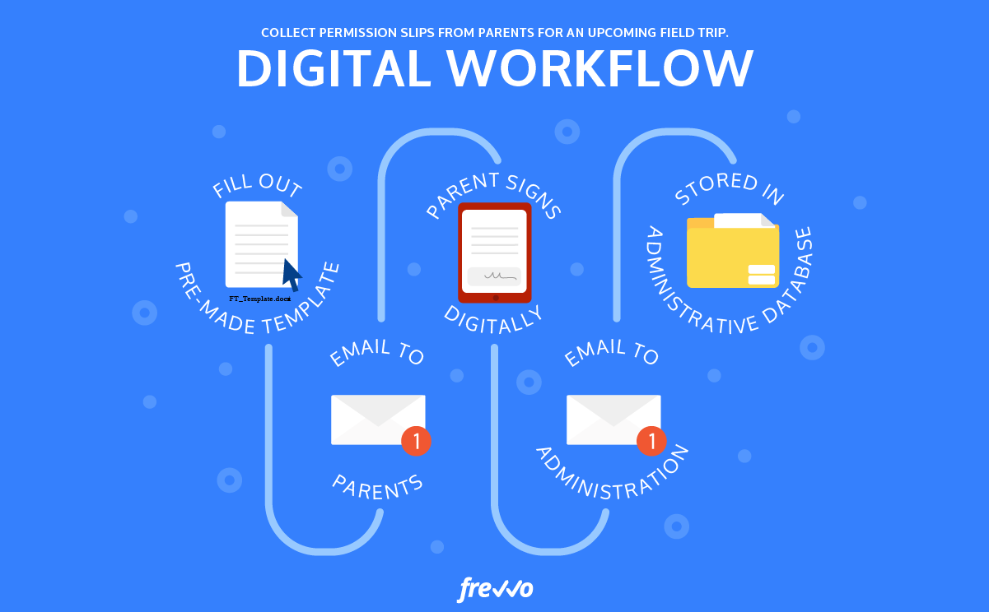
WORKFLOW EXAMPLE

Slide 17
Controlling & auditing
Enterprise control is the ability to combine control, intelligence and process management to enable business optimization that is inclusive of business and production operations. It combines the strength of both business processes and production operations processes.
An audit is a formal examination, inspection, and verification of a commercial enterprise's, organizations, or any entity's accounts. Audits are usually carried out by an independent party.

Slide 18
accounting
Enterprise accounting software comprises modules specific to billing and payroll, accounts receivable, accounts payable, general ledger, and more.

Slide 19
BILLING & INVOICING
BUDGETING & FORECASTING
FUNCTIONS OF ENTERPRISE ACCOUNTING
SOFTWARE
FIXED ASSET
PAYROLL
INVENTORY MANAGEMENT

Slide 20
Enterprise resource planning (ERP)
Enterprise resource planning (ERP) refers to a type of software that organizations use to manage day-to-day business activities such as accounting, procurement, project management, risk management and compliance, and supply chain operations.

Slide 21
Supply chain management (SCM)
Supply chain management (SCM) is the centralized management of the flow of goods and services and includes all processes that transform raw materials into final products.

Slide 22
Customer relationship management (CRM)
Customer relationship management is a process in which a business or other organization administers its interactions with customers, typically using data analysis to study large amounts of information.

Slide 23
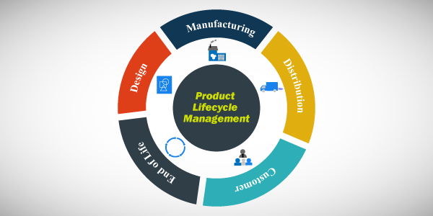
Product lifecycle management (PLM)

Slide 24
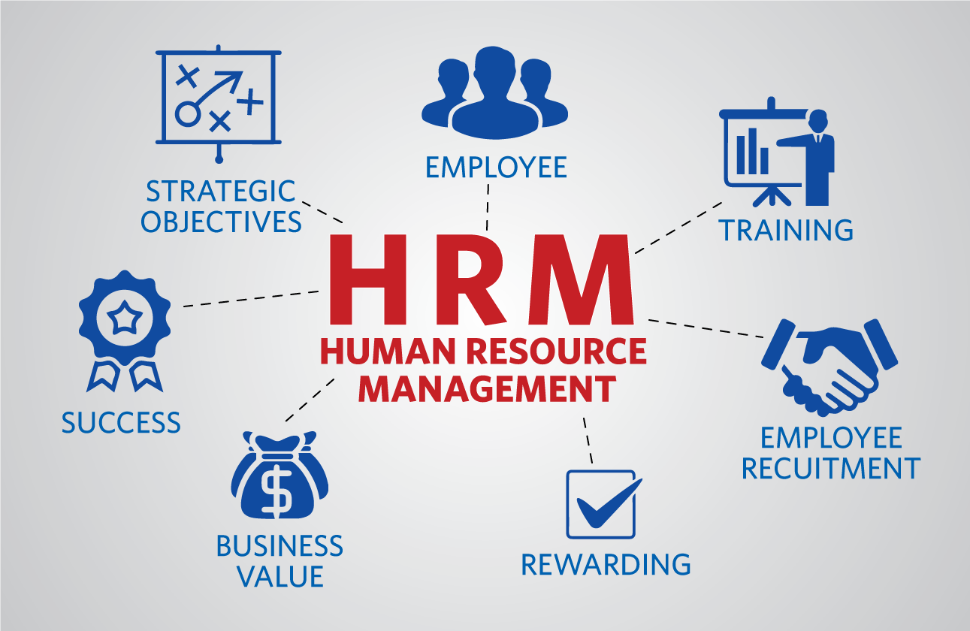
Human resource management (HRM)

Slide 25
General Ledger (GL) sYSTEM
The General Ledger (GL) is the primary accounting record for a business. It tracks all financial transactions and is used to generate the company's financial statements, including the Income Statement and Balance Sheet.

Slide 26

Thank You!
someone@example.com

